Slide 1
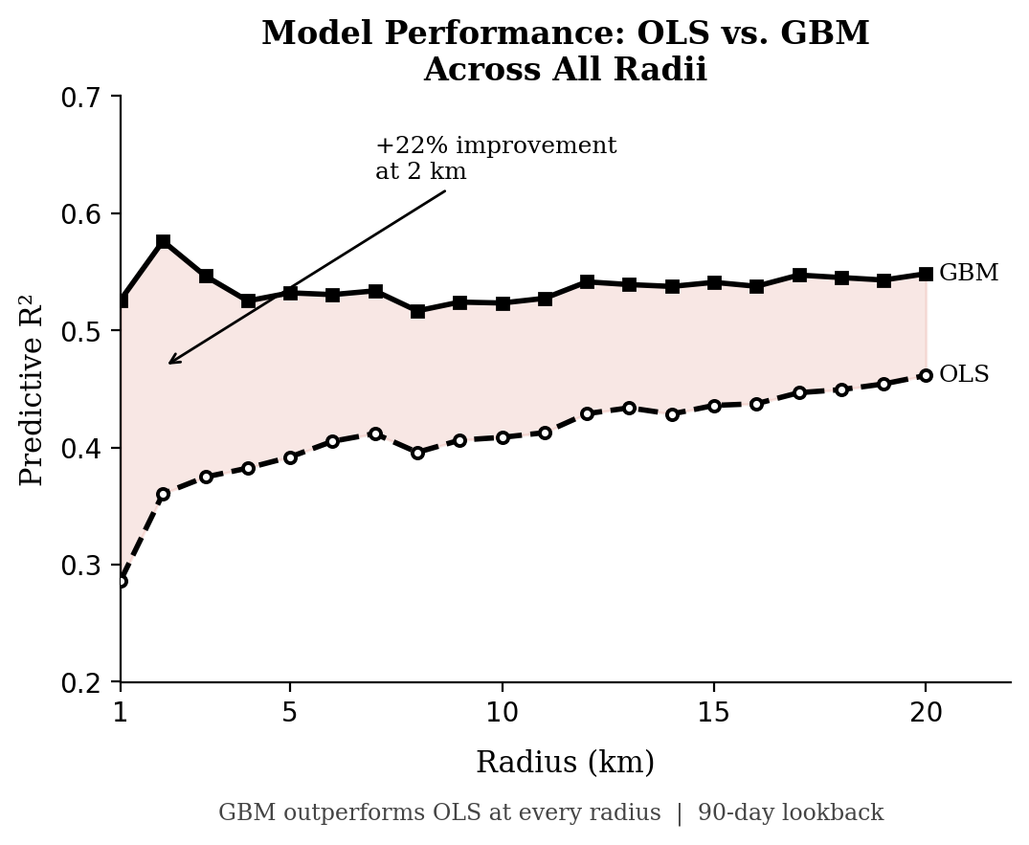
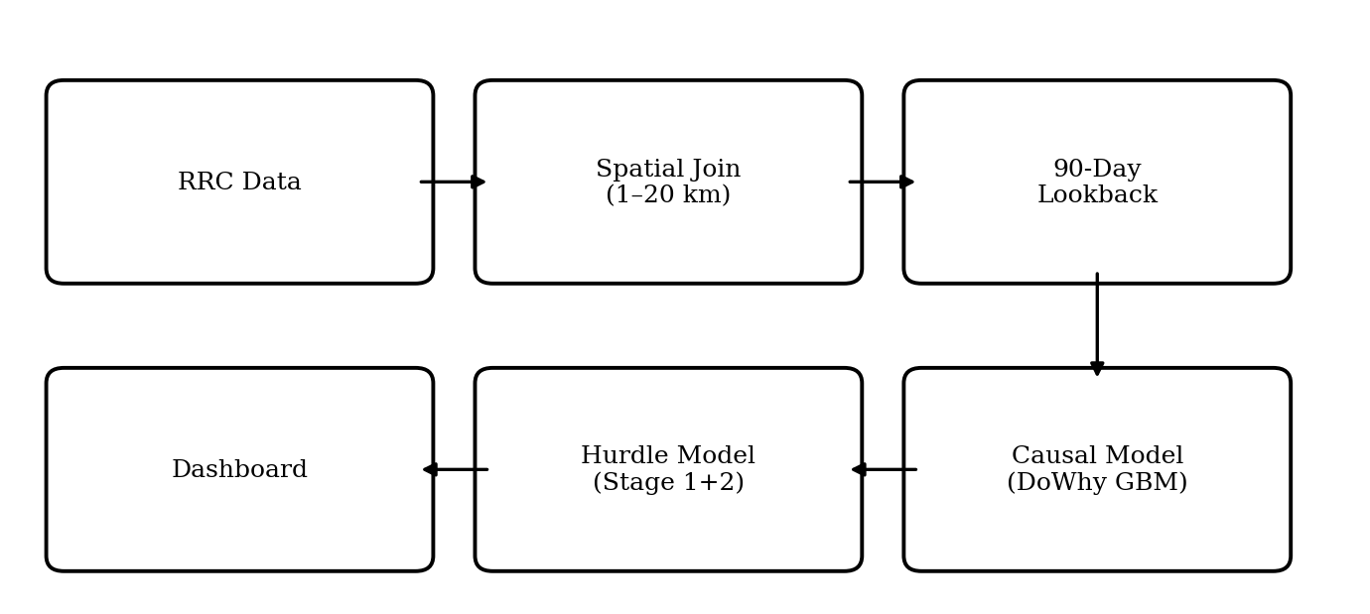
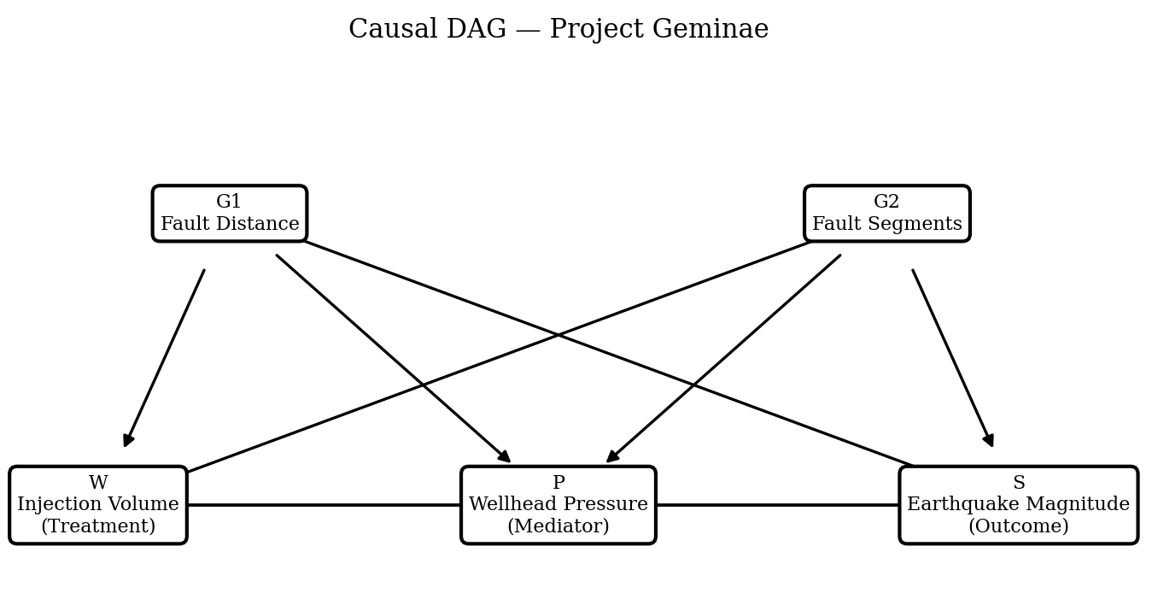
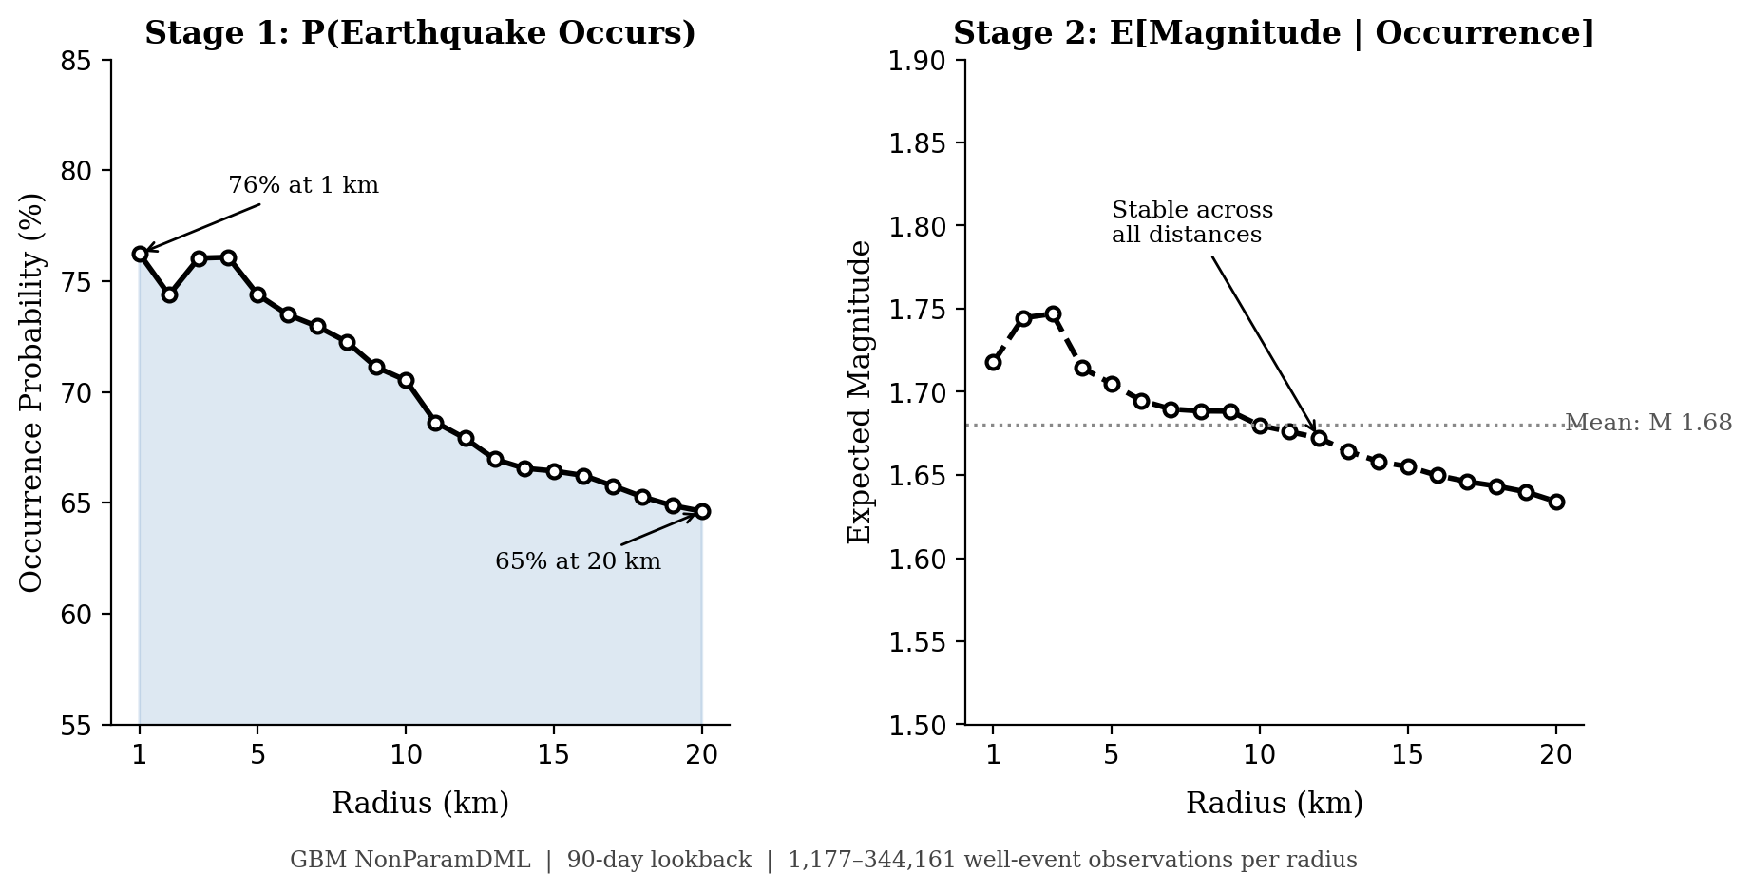
Causal Risk Analytics for Injection-Induced Seismicity
John Smith, MD1;
Jane Doe, PhD2;
Frederick Jones, MD, PhD1,2
1University of Affiliation, 2Medical Center of Affiliation
We linked Texas RRC saltwater disposal records to USGS seismic events across 20 radii (1–20 km) using a 90-day injection lookback window. A causal graph (DAG) structures the relationships between injection volume, wellhead pressure, fault geometry, and earthquake magnitudes, separating what drives injection decisions from what drives seismic outcomes.
Four estimators run in parallel: OLS baseline, Gradient Boosting, Random Forest, and Lasso via the DoWhy causal inference library. A two-stage hurdle model then predicts whether an earthquake occurs (Stage 1) and its expected magnitude if it does (Stage 2).
Saltwater disposal from oil and gas operations in the Permian Basin has been linked to a sharp rise in earthquake activity over the past decade, creating operational, regulatory, and reputational risk for operators. Existing tools for assessing that risk are largely correlational and difficult to act on.
This project builds an end-to-end analytics pipeline that moves beyond correlation to estimate the causal effect of injection activity on earthquake likelihood and magnitude. Using Texas Railroad Commission injection records linked to USGS seismic data across 344,000 well-event observations, we quantify how much injection volume drives seismic outcomes, controlling for fault proximity, pressure, and geology.
The pipeline delivers two actionable outputs: a causal effect estimate by distance from the wellbore (1–20 km), and a two-stage risk model that separately predicts whether an earthquake will occur (Stage 1, AUC 0.97–0.99) and how large it will be if it does (Stage 2, MAE 0.44 magnitude units). Results are reproducible, configurable, and visualized in a live dashboard
The strong Stage 1 classifier performance (AUC > 0.97) reflects a clear spatial signal: fault proximity and injection volume together are near-sufficient to predict whether an event occurs. However, domain expert feedback from a Permian Basin asset geologist (C. Reudelhuber) identified a critical unmodeled distinction, shallow disposal zones (Grayburg, San Andres, Clearfork) are physically disconnected from seismogenic faults, while only deep zones like the Ellenburger drive seismicity. Without disposal-interval data, the model cannot make this separation, and the high AUC may partly reflect fault proximity geometry rather than true injection-seismicity discrimination.
Wellhead pressure, used as a mediator proxy, introduces noise correlated with well age and maintenance history, a known limitation of RRC-reported data. The radial distance framework also assumes isotropic pressure propagation, which expert feedback suggests is physically incorrect; pressure travels along fault planes, not radially. Both limitations have clear resolution paths but require data sources beyond the current RRC dataset.
Operators in the Permian Basin dispose of millions of barrels of produced water daily through saltwater disposal (SWD) wells. Regulators and operators have long observed a correlation between injection activity and nearby earthquakes, but correlation alone cannot tell an operator which wells are driving risk, by how much, or at what distance.
Existing industry tools rely on simple proximity thresholds or linear regression — neither of which accounts for the causal pathway from injection to seismicity, the role of pressure as a mediating mechanism, or the difference between triggering an event and controlling its size. Decisions made on correlational models risk misallocating operational responses.
Sections of this project were developed in direct partnership with a Permian Basin asset geologist to ensure the modeling choices are grounded in field reality. The goal is a tool operators can use: one that separates signal from noise, quantifies risk by distance, and is transparent about what it can and cannot explain.
Injection activity has a statistically significant causal effect on earthquake likelihood and magnitude at every distance tested (1–20 km, p < 0.001). The nonlinear GBM model explains 54% of magnitude variance versus 41% for the linear baseline, confirming that injection-seismicity relationships are likely non-linear.
The hurdle model predicts whether an earthquake occurs with a ROC-AUC of 0.97–0.99 across all radii. Occurrence probability declines from 76% within 1 km to 65% at 20 km. Once triggered, expected magnitude averages M 1.68 and is stable across distance, meaning proximity to injection controls whether an event happens, not how large it becomes.
Conclusion
Injection activity has a measurable, statistically robust causal effect on seismic risk at every distance tested. The nonlinear GBM pipeline outperforms the linear baseline at all 20 radii, and the two-stage hurdle model gives operators two distinct, actionable outputs: the probability an event occurs and its expected magnitude if it does. This project delivers the first end-to-end causal seismic risk pipeline built directly on RRC and USGS data for the Permian Basin.
Next Steps
Formation depth stratification (filtering to deep disposal zones; Ellenburger and below), is the single highest-impact improvement available and the key recommendation from our domain expert collaborator. Additional directions include extending the lookback sweep beyond 90 days, incorporating fault orientation relative to the regional stress field as a confounder, and validating the pipeline against bottom-hole pressure gauge data where available.
[Name]
[Organization]
[Address]
[Email]
[Phone]
1.
2.
3.
7.
8.
9.
Vivek Sriram — vsriram@andrew.cmu.edu
Amitesh Mohan — amiteshm@andrew.cmu.edu
Raymond Tuo — rtuo@tepper.cmu.edu
Janet Liu — janetliu@andrew.cmu.edu
Matthews, L., Molak, A., Reudelhuber, C., Meek, T., Rensi, E., and Ayala, I. (2025). A Causal Inference Pipeline for Injection-Induced Seismicity: Open-Source Methodology and Implementation. SPE-228051-MS, SPE Annual Technical Conference and Exhibition.
Reudelhuber, C. (2026). Expert consultation on Permian Basin disposal formation depth, wellhead pressure reliability, and injection-seismicity lag timescales. Personal communication, April 2026.

